Slide 1
Process Scheduling
Simulator
Ben Robles

Slide 2
Program functionality
A simulator to test variations of work stealing algorithms for parallel processing.
Structure:
Processing:
Task -> Deque -> Workers
Each worker has a deque of tasks
Workers process tasks FIFO
Cycles -> Simulation -> Testbed
Cycles are discrete units of time.
Tasks take variable cycles to complete
Notes:
My project is a simulator to test different work stealing algorithms for parallel processing.
Structurally, the simulator has a set of workers, each with their own deque of tasks to process. Workers process their tasks FIFO
Processing happens over discrete units of time called cycles. The simulator controls the passage of cycles and the test bed runs multiple simulators at once.

Slide 3
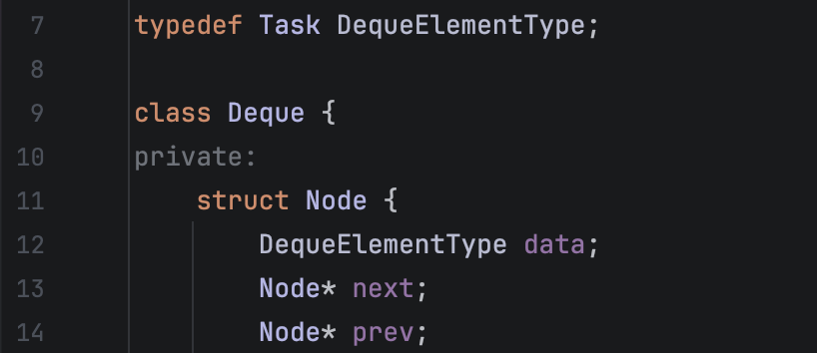
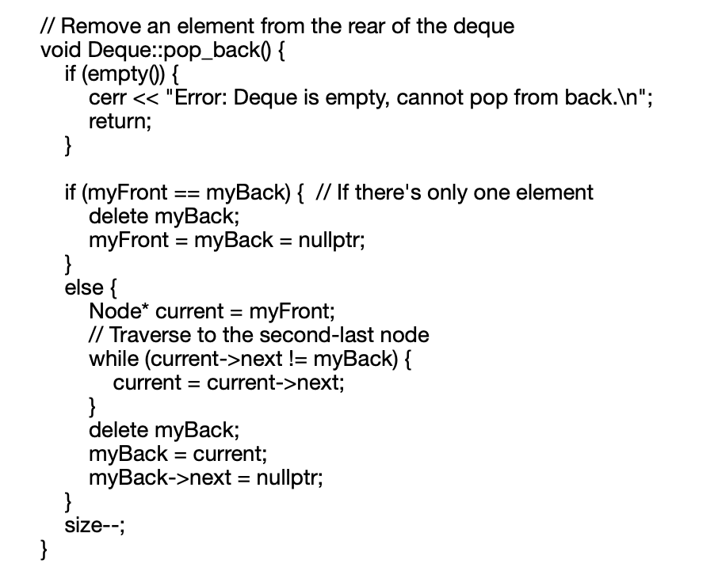
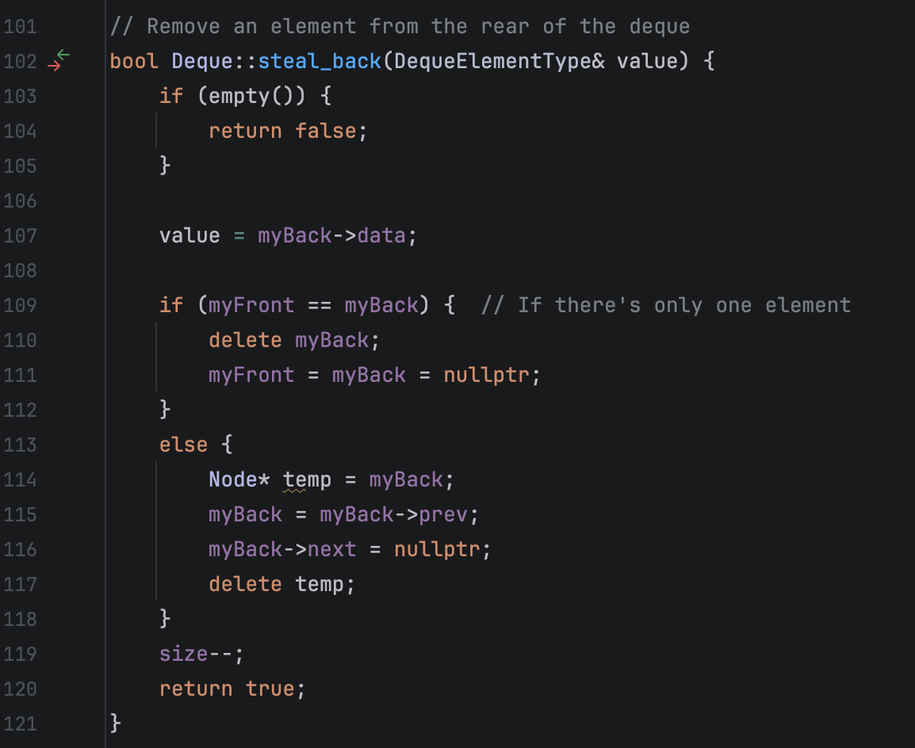
Data Structures and Algorithms (1)
Each worker has a deque implemented by a doubly linked list
Original deque was taken from the singly linked list example
Work is stolen from the back of a victims deque, so changing to a doubly linked list by adding a pointer to the previous node improves the speed of stealing from O(n) to O(1) by avoiding scanning through the deque.
Singly Linked List, O(n)
Doubly Linked List, O(1)
Notes:
Each worker has a deque implemented by a doubly linked list
The design for the deque was taken from the singly linked list example and expanded on.
Since work is stolen from the back of a victims deque, implementing a doubly linked list by adding a pointer to the previous node improves the speed of stealing from O(n) to O(1) by avoiding scanning through the deque.

Slide 4
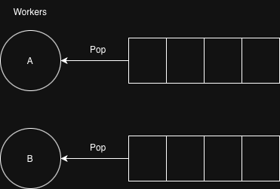
Data Structures and Algorithms (2)
No Work Stealing
Workers exclusively work from their local deque
Simple baseline for comparison
Notes:
The first algorithm is a simple baseline for comparison. There really is no algorithm, workers exclusively work from their local deque

Slide 5
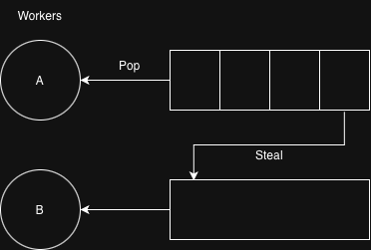
Data Structures and Algorithms (3)
Idle Work Stealing
When a worker becomes idle by having no current task and an empty deque, it attempts a steal
Iterating through the other workers, the thief finds a worker with at least one task in its deque, steals it, and then adds it to its own deque

Slide 6
Data Structures and Algorithms (4)
Priority Work Stealing
Each task has a priority
If a worker doesn’t have a maximum priority task it iterates through other workers deques to look for one and attempt a steal
Each task has a type. Workers complete tasks matching their type faster (in half as many cycles)
For each steal attempt of a maximum priority task, the worker calculates whether it's worth stealing by its type
When no more priority tasks are left, workers default to idle stealing

Slide 7
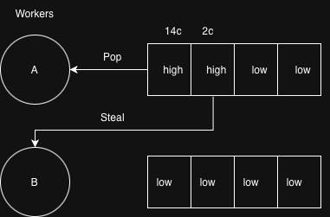
Data Structures and Algorithms (4)
Priority Work Stealing

Slide 8
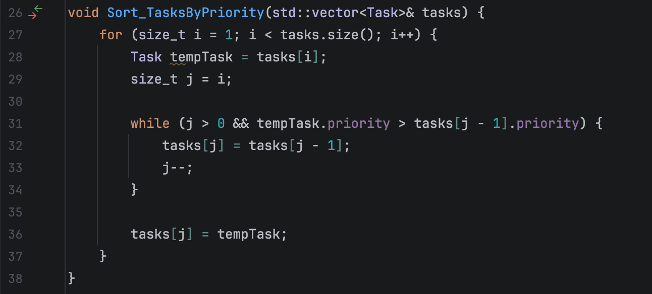
Data Structures and Algorithms (5)
To create a dataset for an experiment, a vector of variable tasks is generated using <random>
The vector of tasks is sorted by priority using insertion sort
Potential improvements
Implement a quicksort when the number of tasks is greater than 20
Modify the underlying data structure to make the deque a priority deque, avoiding the need for sorting

Slide 9
Overview
Testbed
Each worker has a deque of tasks to process
Processing tasks happen by cycle
Simulation ends when all cycles are complete
Tasks are sorted by priority
Each task has a type and are originally assigned to the workers who will do them fastest
A test runs all the simulation types (No, Idle, and Priority work stealing) with the same tasks and stores its results
Tasks are generated per test
Each test:
4 workers
50 tasks: minimum 3 cycles, maximum 40
Maximum priority: 5 (≈ ⅕ probability)
What happens after 1000 tests?

Slide 10
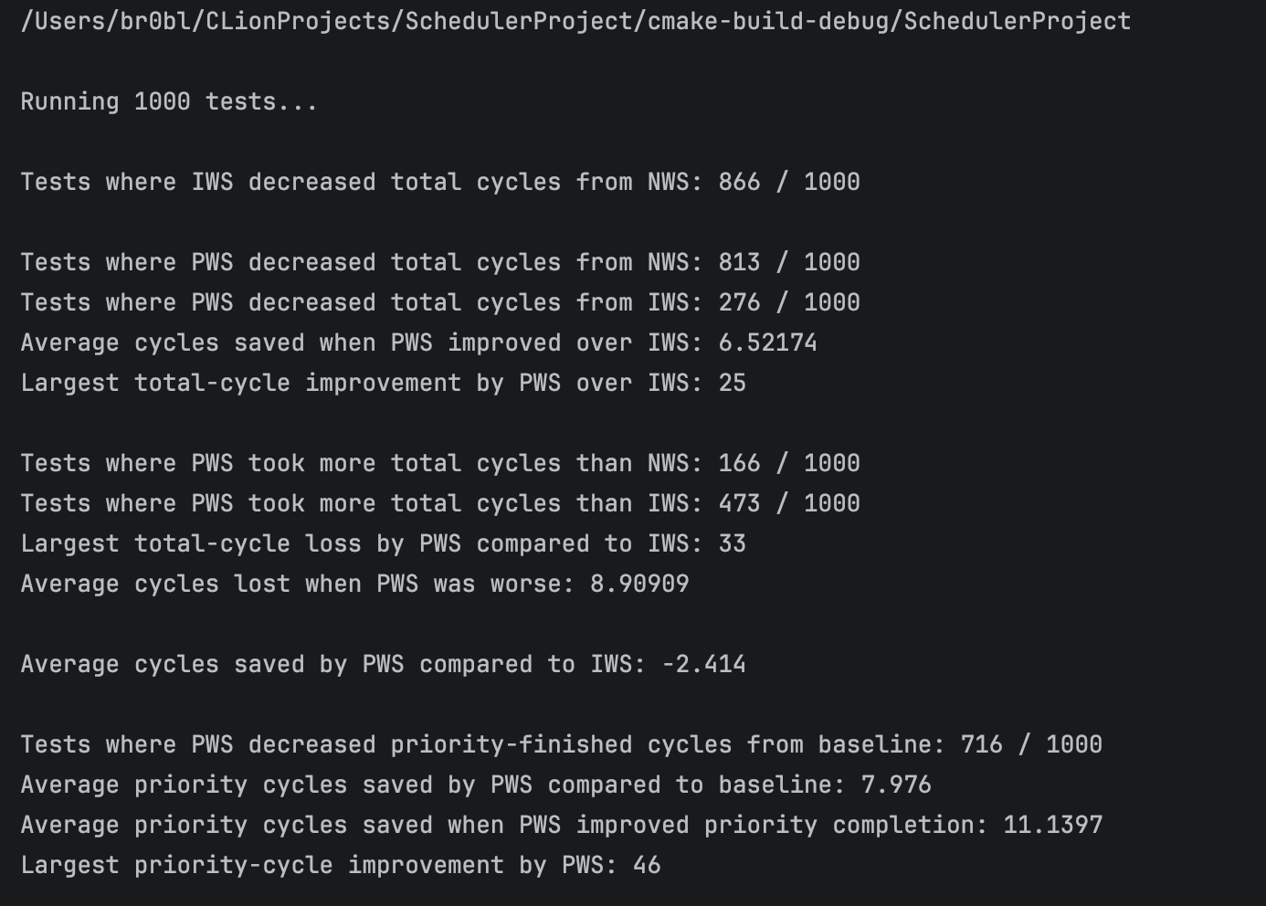
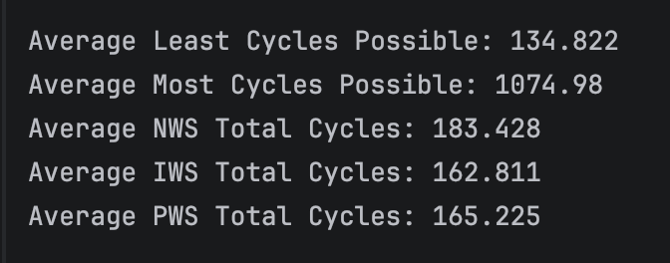
Results

Slide 11
Key Results
Idle work stealing finished in less cycles than no work stealing in 86.6% of tests
Priority work stealing finished in less cycles than idle work stealing in 27.6% of tests
Average cycles saved by priority work stealing compared to idle work stealing: -2.414
Priority work stealing finished priority tasks in less cycles in 71.6% of tests
Average priority cycles saved by priority work stealing: 7.976
Average NWS Total Cycles: 183.428
Average IWS Total Cycles: 162.811
Average PWS Total Cycles: 165.225

Slide 12
Simulation Conclusion
On Average:
Priority work stealing is 2 cycles slower than idle work stealing but finishes priority tasks 7 cycles faster
Any form of work stealing finishes ~20 cycles faster than no work stealing
Idle work stealing is slightly faster, but priority work stealing is more productive

